Slide 1
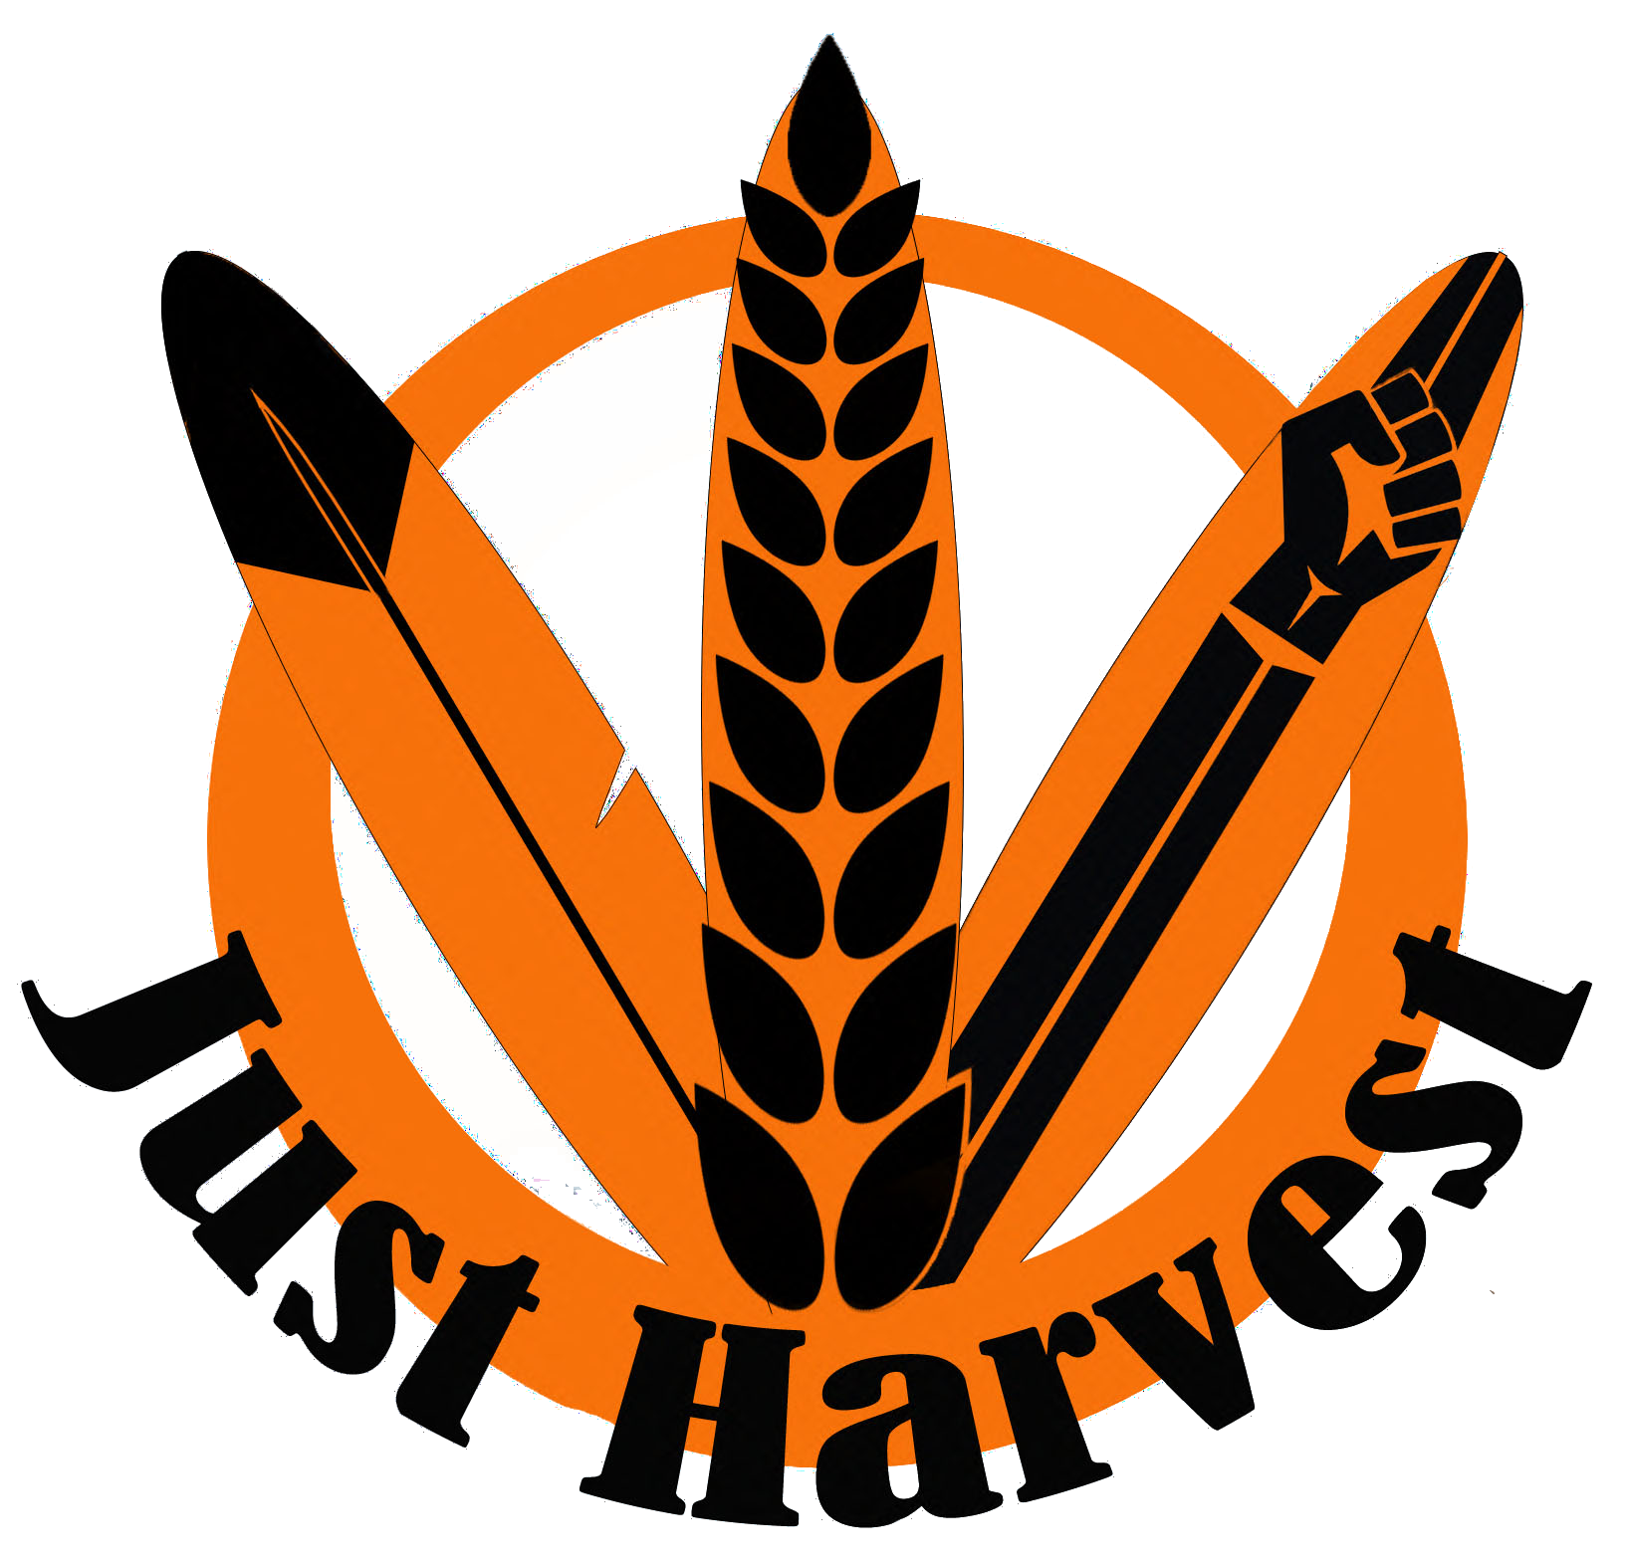
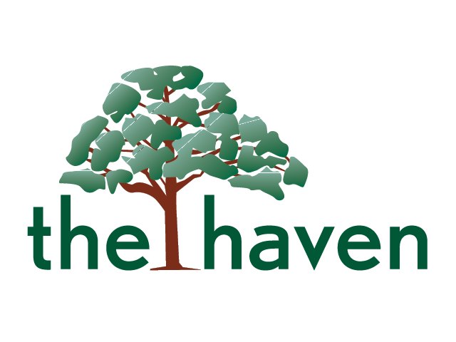
Partners in Wellness
Individual and Community Wellness

Slide 2
Chad Lewis
Community Resilience Coordinator
The Haven
Jay Richardson Grebe
Executive Director
Just Harvest, Va

Slide 3
The Haven
The Haven Shelter & Services, Inc. is committed to preventing and eliminating all types of domestic violence and sexual violence within our service area, which includes Westmoreland, Richmond, Essex, Lancaster and Northumberland Counties.
Just Harvest
The mission of Just Harvest is to promote food sovereignty in Indigenous, Black and other marginalized communities, create sustainable food infrastructures within communities, and reduce the social and economic impacts of hunger.

Slide 4
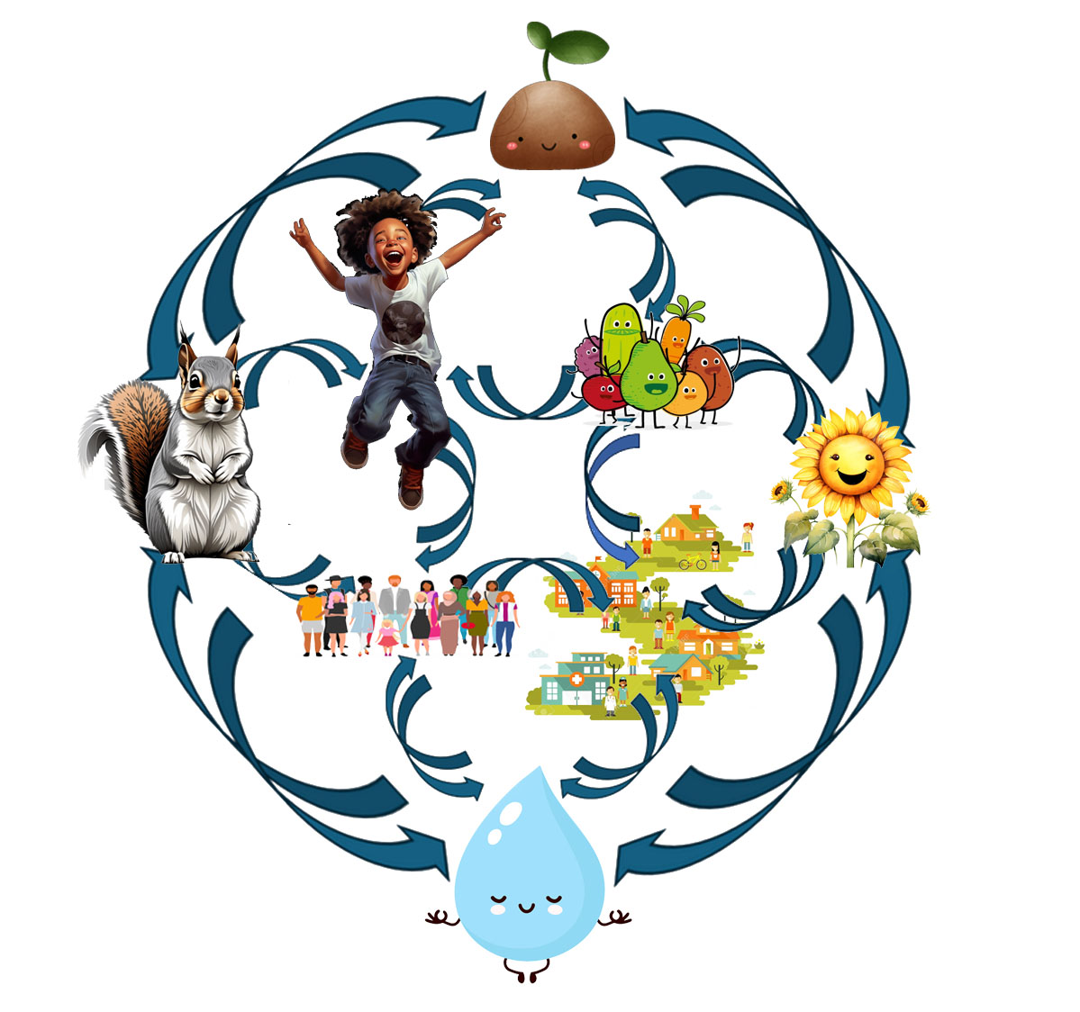
Creating Something Better

Slide 5
Indigenous Philosophy & Native Wellness

Slide 6
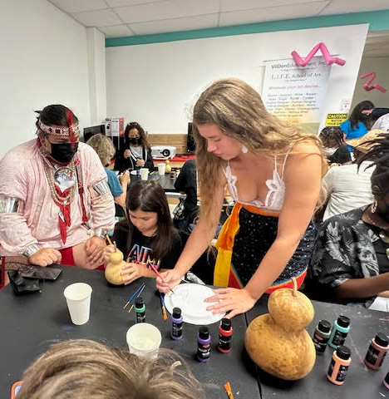
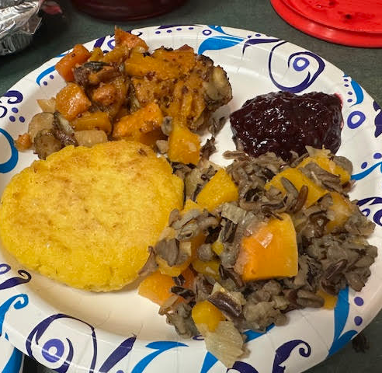
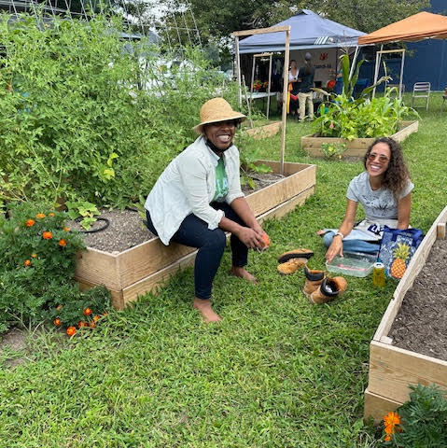
Food Sovereignty & Right Relations
Nutrition
Community
Culture

Slide 7
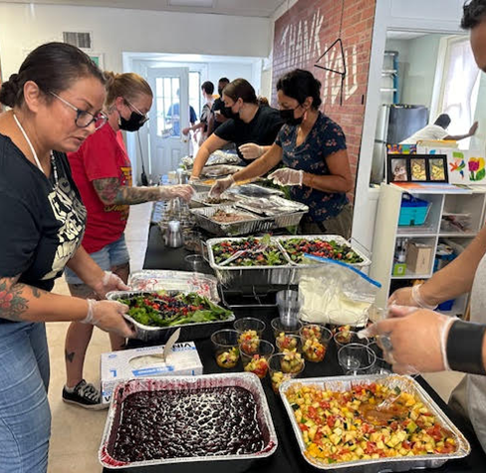
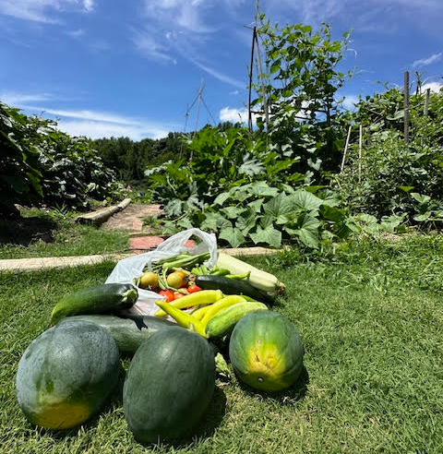
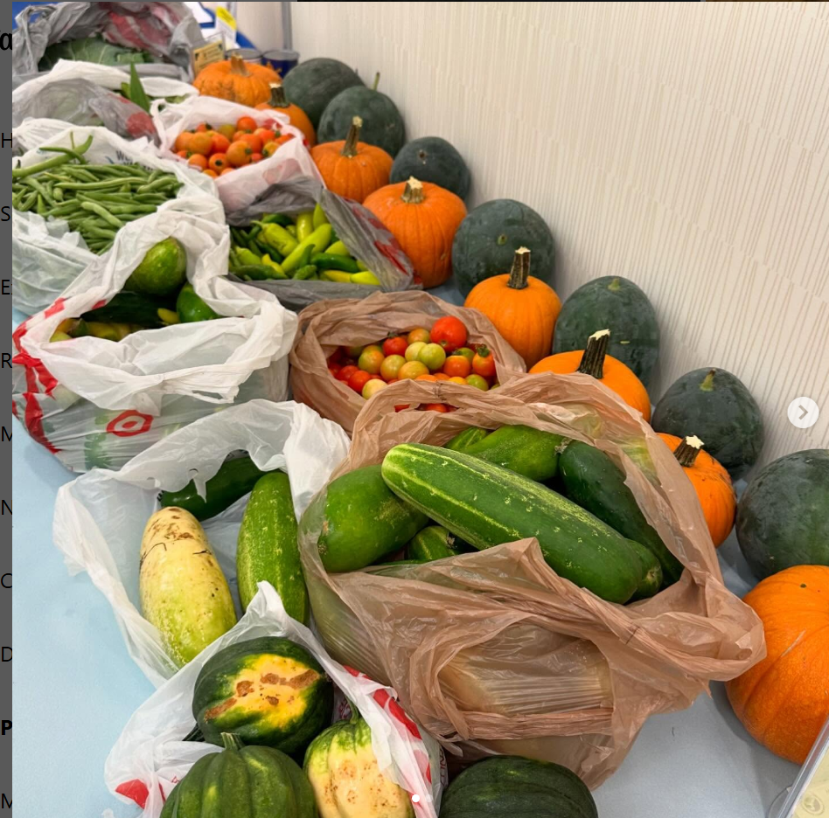
Gardens & Food Distribution
Increasing access to healthy, whole foods
Distributed 1200 pounds of fresh, food directly to the community in 2024
Regenerative Growing techniques
Chemical free, no till agriculture results in more nutritious produce, creates a carb sink and improves the surround ecosystem

Slide 8
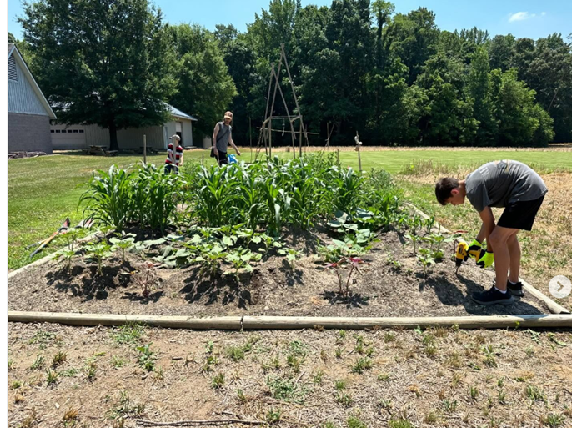
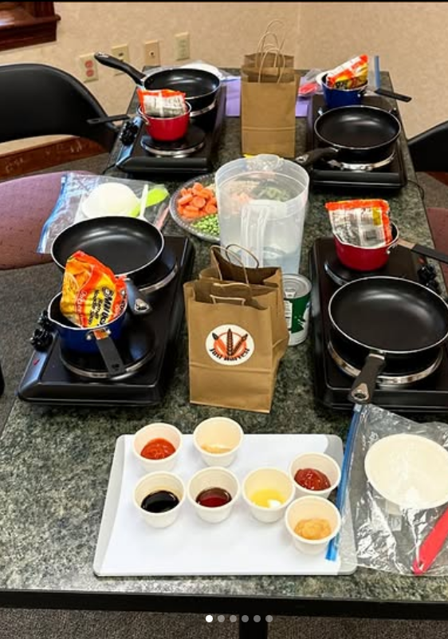
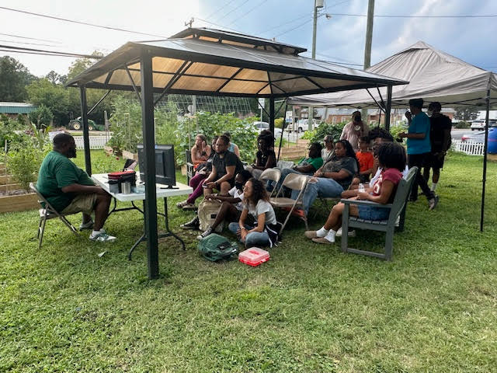
Educational Workshops
Regenerative and Sustainable Growing Practices
Seed Saving
No till gardening
Apartment Gardens
Nutrition Literacy and Cooking Skills
Ramen
Carbs and Cheese
Accurate BIPOC Historical Narratives and Cultural awareness
Storytelling Workshops
Colors of Cultural Exchange
Heritage Gardens at Menokin

Slide 9
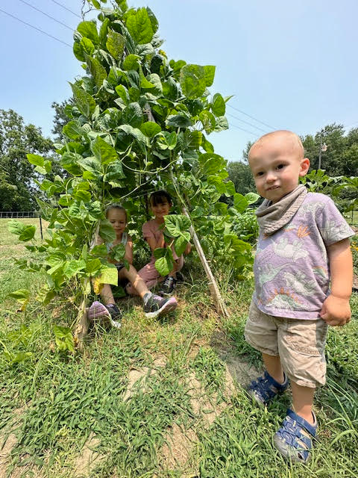
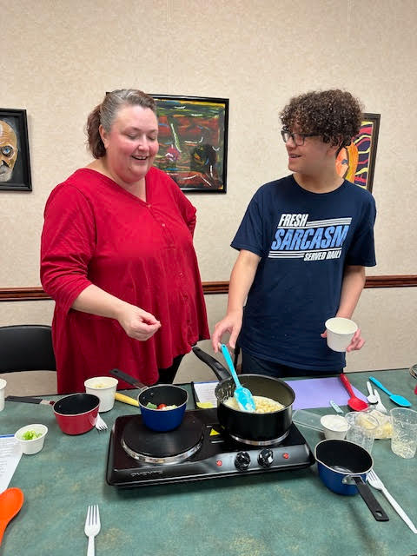
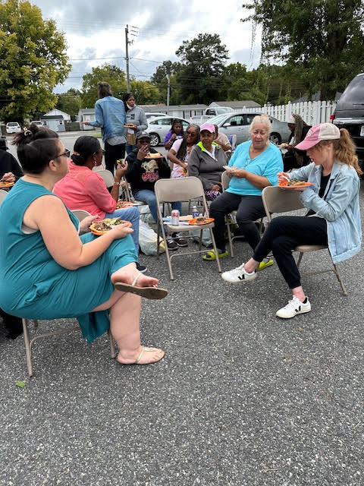
Community & Culture Building
Collaborative approach encourages communication and connection
Cross-cultural engagement
Intergenerational
Lived experience AND academia
Celebration of Diversity
Indigenous values center respect for all
Environmental wellness
Personal wellness
Community wellness

Slide 10
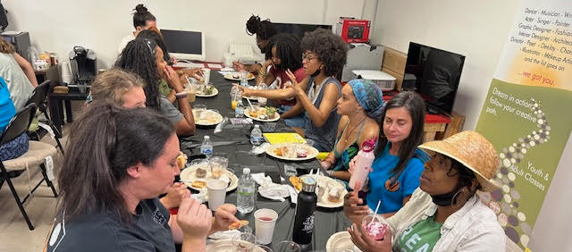
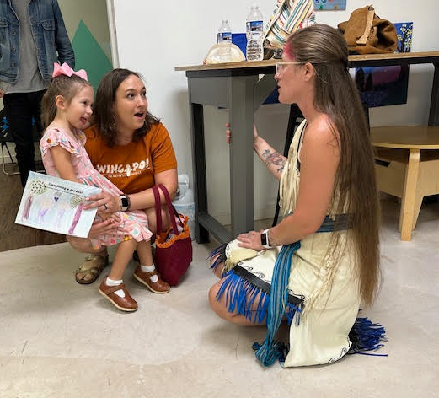
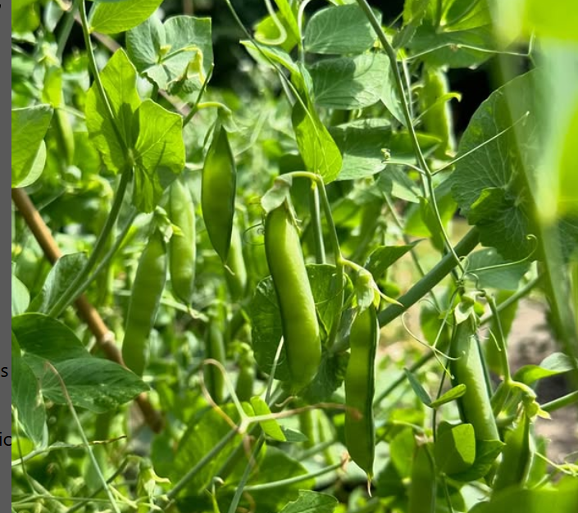
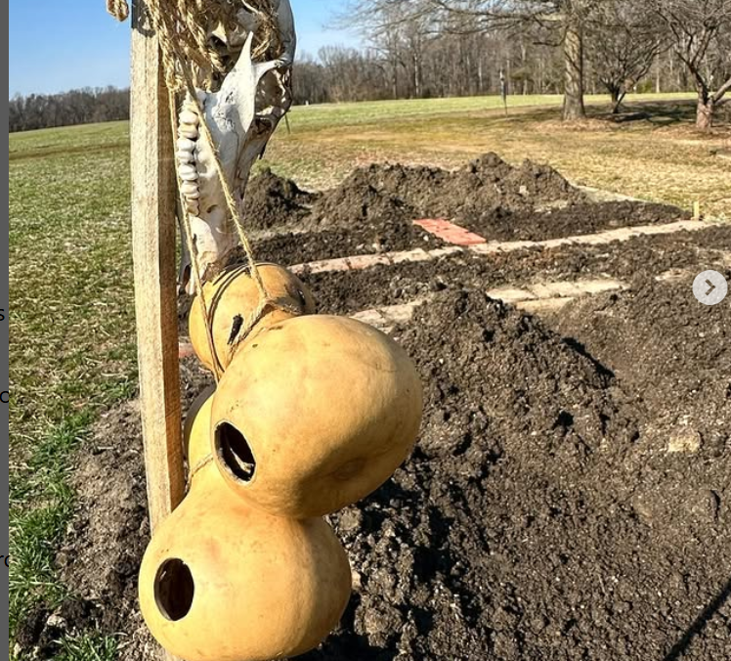
Integrated Approach healthy humans in healthy communities are stewards of holistic wellness
Healthier growing practices create healthier foods, healthier humans, and a healthier environment
Humans flourish both emotionally and physically in safe and welcoming communities
Uplifting Black and Indigenous culture lays the foundation for value systems based on reciprocity, respect for all beings

Slide 11
Community & Culture Building
Collaborative approach encourages communication and connection
Cross-cultural engagement
Intergenerational
Lived experience AND academia
Celebration of Diversity
Indigenous values center respect for all
Environmental wellness
Personal wellness
Community wellness
Uplifting Black and Indigenous culture lays the foundation for value systems based on reciprocity, respect for all beings

Slide 12
Past Workshops, and planning for the future…

